Slide 1
Nutrition Apps and other nutrition info
2014

Slide 2
10 healthy eating apps this nutritionist loves
By Cynthia Sass, Health.com on CNN
Wed April 30, 2014
http://www.cnn.com/2014/04/30/health/healthy-eating-apps/index.html?hpt=hp_c3

Slide 3
Situation: Yikes! Organic pineapple is twice the price. Is it OK to buy the non-organic?
App:
Dirty Dozen
by EWG
Notes:
I think it's always best to go organic when you can, but the benefits of fitting in at least five daily servings of fruits and veggies outweigh the risks of consuming non-organic varieties.
That said, I want to do my best to minimize my pesticide exposure, and that's exactly what this app helps me to. It lists the "Dirty Dozen" -- the 12 most contaminated types of produce, as well as the "Clean Fifteen" -- those least likely to contain multiple pesticide residues. I know many of these by heart, but 27 types is a lot to keep track of, so accessing the lists in just a few clicks is super helpful when I'm at my local grocery store or farmer's market. By the way, pineapple is one of the "Clean Fifteen."

Slide 4
Situation: I need to look up a food additive, stat!
App: Chemical Cuisine
Notes:
When I pick up a packed food, the very first thing I do is read the ingredient list. And while my training has left me familiar with most, I sometimes still spot additives that leave me scratching my head (most recently thaumatin, a natural sweetener I hadn't yet heard about).
My previous modus operandi would be to whip out my iPhone and do a quick Google search, but this app from Center for Science in the Public Interest (CSPI) may offer a shortcut. It provides a brief description of over 130 additives, along with an overall evaluation of either "safe," "cut back," "caution," "avoid," or "certain people should avoid." Even if I don't always agree with the rating, I appreciate the summary, so I can make my own informed decision about whether or not to let an ingredient into my grocery cart.

Slide 5
Situation: I have a ton of leftover mint (or other ingredient). What should I do with it?
App: Whole Foods Recipes
Notes:
I love to get creative in the kitchen, but I also find inspiration from browsing existing recipes. From new ways to enjoy staples, like quinoa, to ideas based on course (salads, side dishes, soups), cuisine (Cajun, Moroccan, Southwest...), or special diet (gluten free, vegan, low sodium), this app is fun, user-friendly, and offers some pretty cool features, including shopping lists, meal planners, and "On Hand," which provides suggestions based on typing in the ingredients you already have.

Slide 6
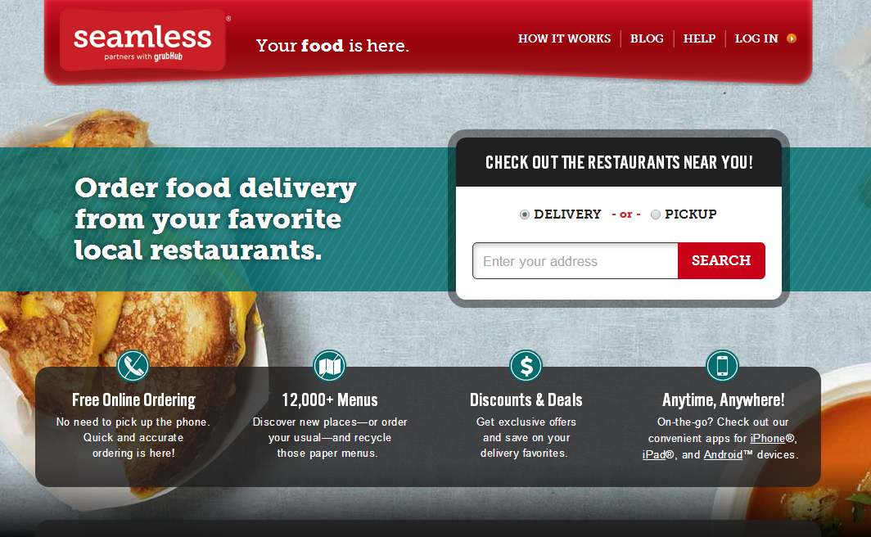
Situation: I need a healthy meal delivered to my door
App: Seamless
Notes:
I recently moved to a new neighborhood, so I'm still getting to know the healthy selections in my area. Seamless is making it easier, because I can narrow my take out options by the designation 'healthy,' or search ethnic cuisines known for healthy dishes, like Japanese and Mediterranean.
Even better, I can sort further based on price, rating, distance, estimated delivery time, or new restaurants only, and once my order is placed, a tracker will let me know when it's ready. Healthy convenience.

Slide 7
Situation: Hubby is craving seafood for dinner -- what's the safest choice?
App:
Seafood
Watch
Notes:
This multifaceted app shows users how to select sustainable seafood options, both regionally and nationally, by using a red, yellow, or green rating (red means either overfished or caught or farmed in ways that harm other marine life or the environment; yellow means better, and green indicates the best all around options for the environment).
But my favorite tool is the "Super Green" list, which includes sustainable choices that are also low in common contaminants, like mercury and PCBs, and high in healthy omega-3 fatty acids. Based on the app, I see Alaskan salmon in my hubby's future.

Slide 8
Situation: I'm out of my neighborhood or traveling -- where can I find a healthy meal?
App:
Food Tripping
Notes:
In addition to helping me find healthy alternatives to fast food wherever I am, this app identifies healthy food markets, juice joints, coffee houses, artisan food shops, vegan options, and farmer's markets. I even found some new spots in my own neighborhood I hadn't heard about yet, and I can suggest my own favorites that are missing. Love, love, love.

Slide 9
Situation: I'm grocery shopping and I want a faster way to find the healthiest products.
App:
Fooducate
Notes:
What doesn't this app do? Fooducate's database contains over 200,000 products, each with a letter grade based on nutritional value, along with things to know about a product (like if it contains any artificial additives), and healthy alternatives. Using your phone's camera, you can also scan a product's UPC code to access quick info.
I tried it with my unsweetened almond milk, and it suggested a DIY recipe for how to make my own (which I have done, but not in a while, so good reminder!). The app also allows you to search for foods by category or brand name, so if I'm at a market and want to look for the healthiest mustard for example, I can search the app first, rather than having to inspect every jar on the shelf.

Slide 10
Situation: Is spaghetti squash still in season?
App: Seasonal and Simple
Notes:
I could spend hours scrolling through this app. In addition to charting what's in season each month of the year, I love being able to search the produce list alphabetically, to access key nutrients, and tips about how to select, store, and prep my favorite plants. There are also deliciously simple recipes for each fruit and veggie, from grilled radishes to ratatouille, sauteed cabbage, and pickled beets (my mouth is watering just typing this). Truly an app that lives up to its name!

Slide 11
Situation: Is this popcorn non-GMO?
App:
Non-GMO Project
Notes:
Because GMO foods aren't labeled as such, one of the only ways to avoid them is to buy USDA certified organic products. But that's not practical 100% of the time, and while GMO seeds and ingredients are not supposed to be used in organic products, no testing is required to show whether GMO cross-pollination or contamination has occurred.
Enter this app, which features a list of the brands and products enrolled in the Non-GMO Project's Product Verification Program. According to ABC News, 93% of those polled believe that GMO products should be labeled, and nearly 60% say they'd be less likely to buy GMO foods. If you agree, this app takes away the guesswork - search by product type, brand name, product name, and keyword.

Slide 12
Situation: I've been rushing around all day, but I want to slow my pace as I eat.
App:
Eat Slower
Notes:
I adore this app! It's so simple, yet so impactful. Simply set your pace, from 20 seconds to three minutes, press start, savor your food, and don't take another bite until the interval has ended and the 'bite' bell goes off.
Eating slower has been shown to enhance meal enjoyment, boost satiety, and result in naturally eating less. In my experience with clients, it can also help break the habit of multitasking, which can lead to mindlessly overeating, or disconnected eating, which can trigger bloating or lingering cravings.
If you tend to eat fast, use the app to work your way up from 30 or 45 seconds between bites, to one minute, one and half, then two, and three. Pacing yourself even once a day can result in eating slower at every meal, and I bet you'll be amazed at the impact.

Slide 13
Plus two more….

Slide 14
Choosemyplate.gov

Slide 15
Myfitnesspal
App:
My
Fitness
Pal

