Slide 1
Nutrition

Slide 2

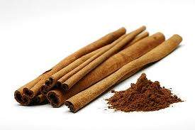
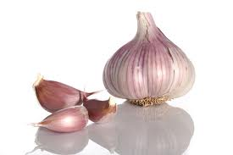
Match the health claim with the ingredient
Health Claim
Ingredient
Is good for your heart
Lowers cholesterol
Stabilizes blood sugar
Combats nausea
Garlic
Cinnamon
ginger

Slide 3
You are famished but trying to shed a few pounds… Which should you snack on?
Popcorn
Crackers
Almonds
Rice cakes

Slide 4
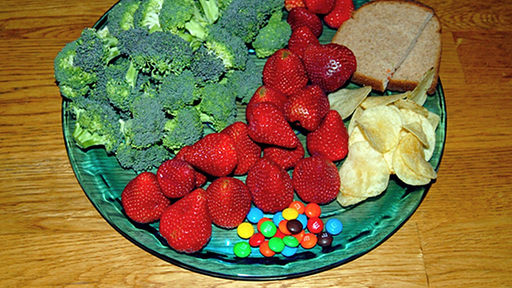
Healthy food no more costly than junk food, government finds 2012
An Agriculture Department study released Wednesday m May 16, 2012 found that most fruits, vegetables and other healthy foods cost less than foods high in fat, sugar and salt.
In fact, carrots, onions, pinto beans, lettuce, mashed potatoes, bananas and orange juice are all less expensive per portion than soft drinks, ice cream, chocolate candy, French fries, sweet rolls and deep-fat fried chicken patties, the report says.
"The price of potato chips is nearly twice as expensive as the price of carrots by portion size”

Slide 5
Dietary Guidelines 2010
Reduce the incidence and prevalence of overweight and obesity of the US population by reducing overall calorie intake and increasing physical activity.
• Shift food intake patterns to a more plant-based diet that emphasizes vegetables, cooked dry beans and peas, fruits, whole grains, nuts, and seeds. In addition, increase the intake of seafood and fat-free and low-fat milk and milk products and consume only moderate amounts of lean meats, poultry, and eggs.
• Significantly reduce intake of foods containing added sugars and solid fats because these dietary components contribute excess calories and few, if any, nutrients. In addition, reduce sodium intake and lower intake of refined grains, especially refined grains that are coupled with added sugar, solid fat, and sodium.
• Meet the 2008 Physical Activity Guidelines for Americans.

Slide 6
Your gym suggests keeping a fitness journal to track your progress in the new year. What is the most important detail to put in it?
Focus on one reason to stay fit each week... Like being able to hike or run longer. To keep up with your friends, etc.

Slide 7
Nutrition Lingo
Free Radicals
I think of free radicals as nasty little bullies. They are generated in our bodies every day and we build up even more when we're under stress or are exposed to pollutants like smog and cigarette smoke, and even when we exercise. They are basically oxygen molecules that have become unstable, like a chair with 3 legs. In an attempt to stabilize, they attack healthy cells to steal their electrons -- this damages the cell and can lead to premature aging and disease. This process is called oxidation or oxidative stress and the oxidation of "bad" LDL cholesterol creates a domino effect that can lead to heart disease and stroke, which is why you hear so much about free radicals in relation to heart health. You can't totally eliminate free radicals, but antioxidants can help fight them.

Slide 8
Antioxidant
Antioxidants are like little bodyguards that protect your cells from free radicals. They essentially donate electrons to those nasty bullies to stabilize them and render them harmless. There are dozens of antioxidants, like beta-carotene found in carrots and flavanols in dark chocolate. A common example of antioxidants in action is how lemon juice protects apples: If you slice a fresh apple, the wedges turn brown from oxidation, but tossing the wedges with lemon juice, which contains vitamin C -- an antioxidant -- fights oxidation and prevents the browning.

Slide 9
Phytochemical
Phytochemicals … polyphenols … antioxidants … what do all of these terms mean?
The term phytochemicals is a broad name for a wide variety of compounds produced by plants. They’re found in fruits, vegetables, beans, grains, and other plants. Each phytochemical comes from a variety of different plant sources and has different proposed effects on, and benefits for, the body. Some researchers estimate there are up to 4,000 phytochemicals! Scientists have identified thousands of them, although only a small fraction of phytochemicals have been studied closely.
Common Names for Phytochemicals: antioxidants, flavonoids, phytonutrients, flavones, isoflavones, catechins, anthocyanidins, isothiocyanates, carotenoids, allyl sulfides, polyphenols

Slide 10

Benefits of phytochemicals
New experimental studies are emerging that demonstrate multiple effects of fruits and vegetables (and their phytochemicals), suggesting that they may have an even greater role to play in human health than the already positive results seen to date. Check out the top 6 phytochemicals… see the next slide!

Slide 11
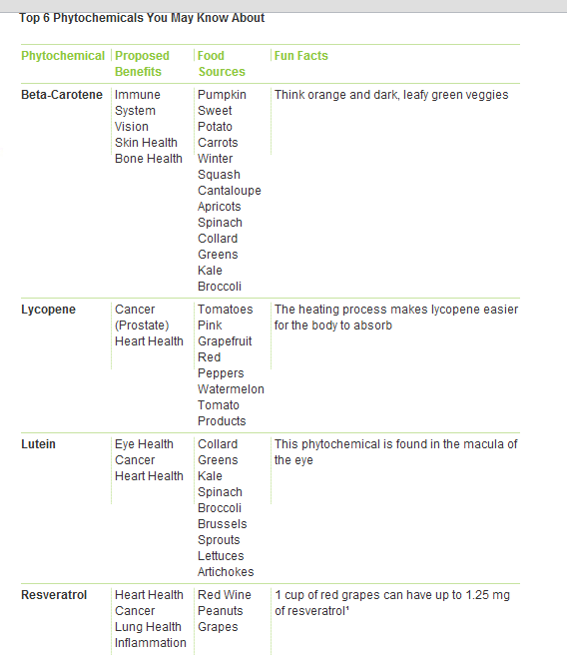

Slide 12
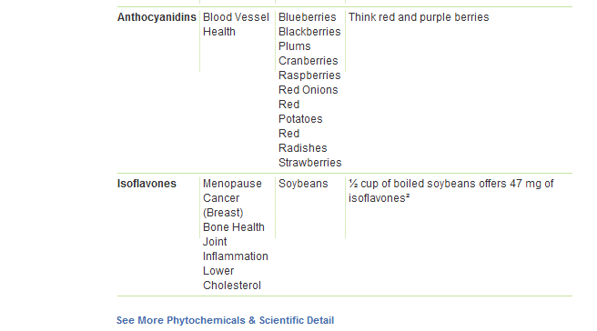

Slide 13
Glycemic Index
In a nutshell, the glycemic index essentially measures how quickly a food will raise your blood sugar.
GRAINS | Glycemic index (glucose = 100)
Couscous, average | 65
Quinoa | 53
White rice, average | 89
Brown rice, average | 50
Coco Pops™, average | 77
Cornflakes™, average | 93
BEVERAGES | Glycemic index
Coca Cola®, average | 63
Cranberry juice cocktail (Ocean Spray®) | 68
Gatorade | 78
Orange juice, unsweetened | 50
http://www.health.harvard.edu/newsweek/Glycemic_index_and_glycemic_load_for_100_foods.htm
Notes:
Foods are assigned a score on the index -- the higher the score, the faster your blood sugar will rise and vice versa. High is considered a rating of 70 and above and low is 55 or below. Sugary cereals rank over 100 and beans are about 40. But there's a catch -- the index was created using 50 gram portions of single foods. When you eat foods together they do interact, so a low glycemic food can blunt the effects of a high glycemic food if eaten together. And it's important to note that not all high glycemic foods are unhealthy and not all low glycemic foods are healthy. For example, some fruits are very high and ice cream is low. The most important goal is still quality, overall nutritional value and healthy, balanced combinations

Slide 14
Energy Dense vs Nutrient Dense
Energy density essentially means how many calories a food packs per bite. Low energy dense foods have fewer calories and high energy dense foods have more calories. For example, one cup of veggies only packs about 25 calories, but a mere tbsp of oil packs 120. Generally the more water, fiber and air in a food, the lower the energy density…
Nutrient Dense foods have more nutrients and less calories…

Slide 15
Daily Value
You'll see Daily Value on food labels. Each line tells you the amount of a nutrient one serving of the food contains compared to either the minimum or maximum target for the average adult. For example, 15 percent of the Daily Value for fiber means one serving provides 15 percent of the amount of fiber you need daily. It's especially helpful for quickly comparing two similar foods, like two types of cereal for their fiber values or two types of soup for their sodium values. But in my opinion the ingredient list of a packaged food provides the most important information. While a product may be a good source of something you want more of (like protein) or offer none of a nutrient you're trying to avoid (like sodium or sugar), it could still be loaded with artificial additives and preservatives. My motto: ingredients lists should read like recipes you could easily recreate in your own kitchen.

Slide 16
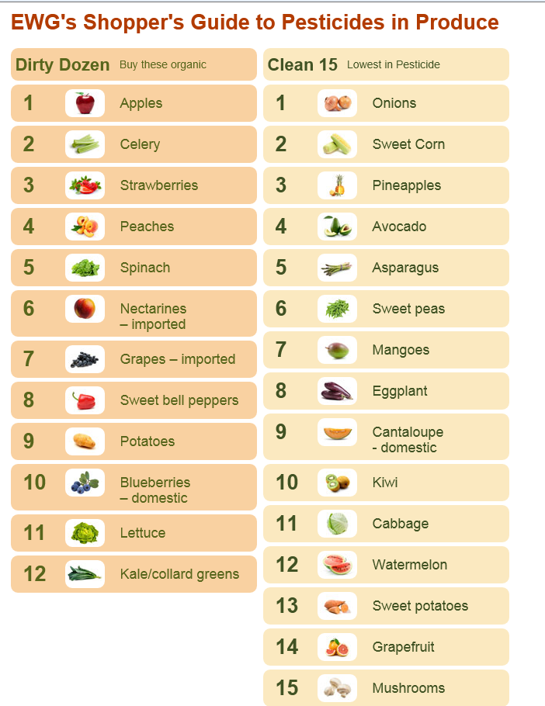
You can reduce your exposure to pesticides by up to 80 percent by buying the organic versions of the “Dirty Dozen”.

Slide 17


Slide 18
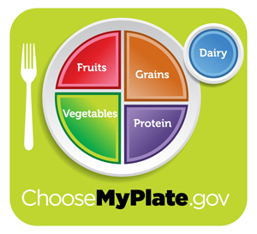
Choosemyplate.gov

Slide 19
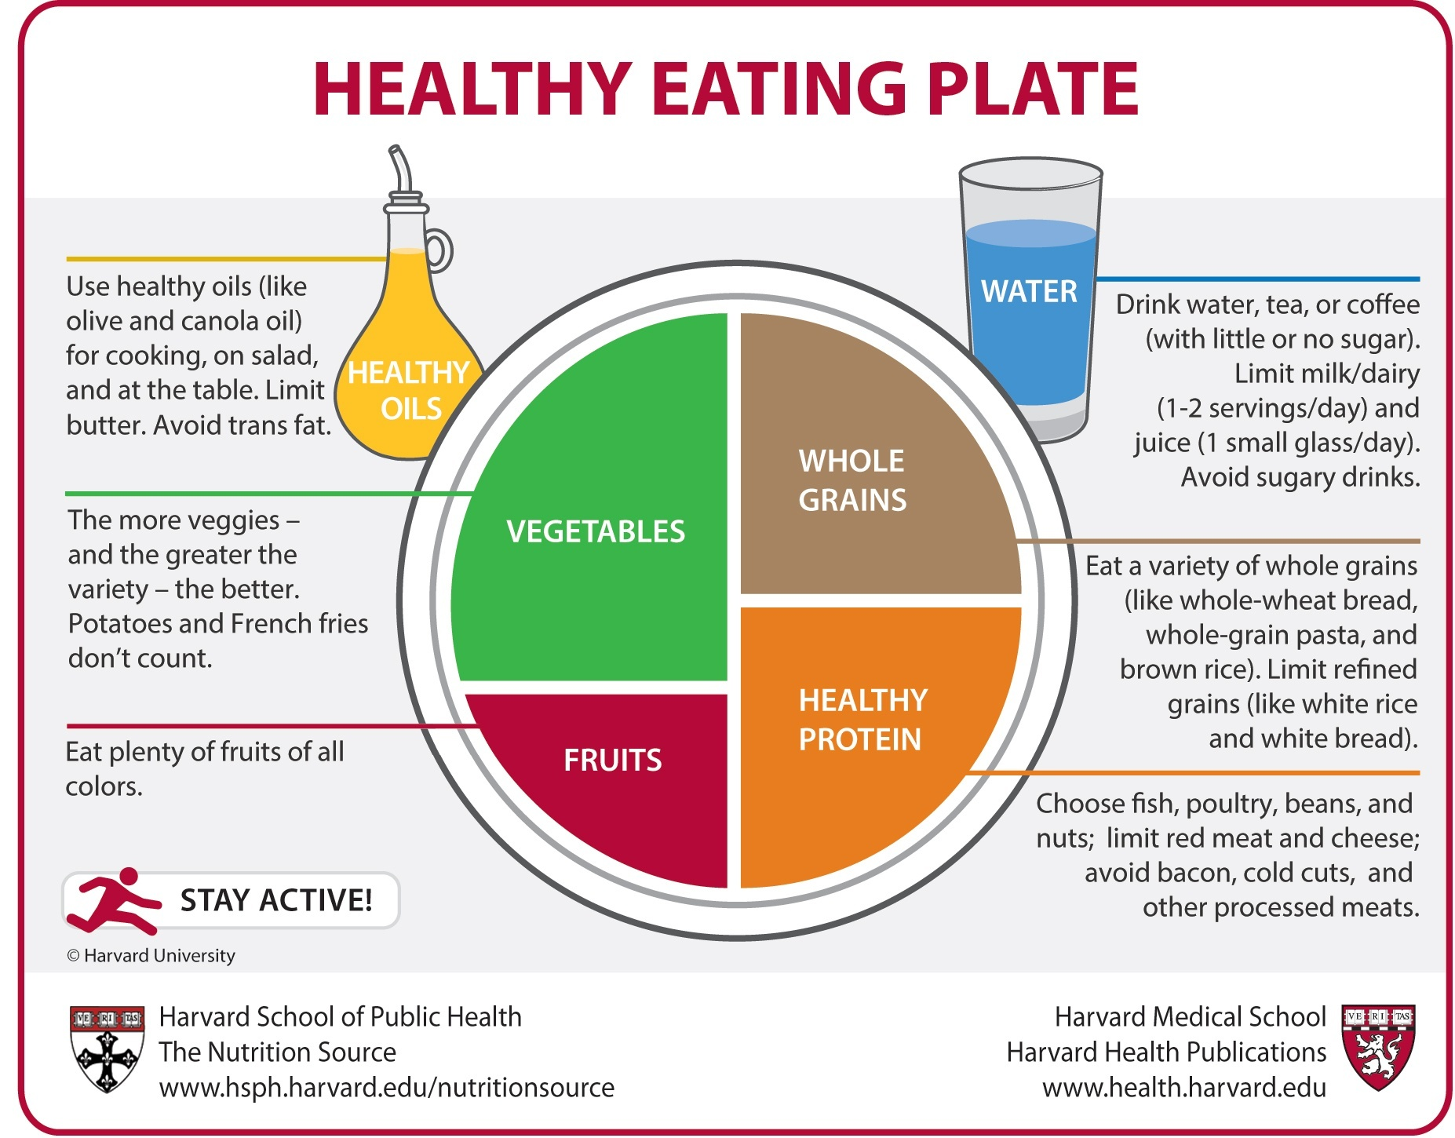

Slide 20
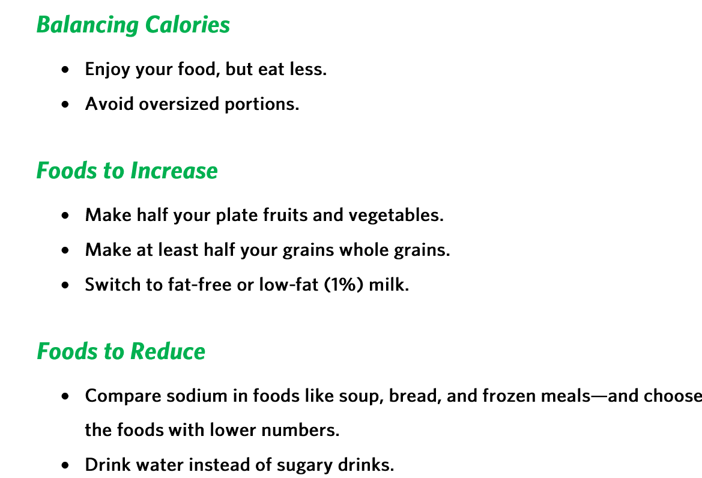

Slide 21
Foods to help
Whiter Teeth: Celery
Strong Nails: Walnuts
Healthy Hair: Beans
Flawless Skin: Squash, Liver and Salmon

Slide 22
Fats
Limit the amount of saturated (animal fats, butter, dairy) fat in your diet
No more than 25% of your daily calories should come from fat
Good sources of poly-unsaturated fats: pistachio nuts, sunflower seeds, walnuts, fatty fish (salmon/trout), corn oil, soybean oil.

Slide 23
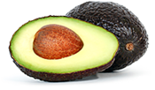
Why is it important to consume the healthy oils/fats?
Oils are not a food group, but they do provide essential nutrients and are therefore included in USDA recommendations for what to eat.
Most of the fats you eat should be polyunsaturated (PUFA) or monounsaturated (MUFA) fats. Oils are the major source of MUFAs and PUFAs in the diet. PUFAs contain some fatty acids that are necessary for health—called "essential fatty acids."
The MUFAs and PUFAs found in fish, nuts, and vegetable oils do not raise LDL ("bad") cholesterol levels in the blood. In addition to the essential fatty acids they contain, oils are the major source of vitamin E in typical American diets. And help with the absorption of the fat soluble vitamins (A,D, E, K)
While consuming some oil is needed for health, oils still contain calories. In fact, oils and solid fats both contain about 120 calories per tablespoon. Therefore, the amount of oil consumed needs to be limited to balance total calorie intake

Slide 24
Fats that contribute to Heart Disease
Solid fats are fats that are solid at room temperature, like butter and shortening. Solid fats come from many animal foods and can be made from vegetable oils through a process called hydrogenation. Some common fats are:
butter
milk fat
beef fat (tallow, suet)
chicken fat
pork fat (lard)
partially hydrogenated oil (TRANS FATS): stick margarine, shortening, etc.
Cholesterol comes from foods of animal origin… meat, butter, organ meats, etc.

Slide 25
How to increase your HDL’s and lower your heart disease risk
Exercise
Healthy diet
Do NOT smoke cigarettes

Slide 26
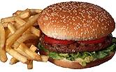
High Fat meals
Australian researchers tested people with asthma before and after a high-fat meal or after a low-fat meal, and found that the high-fat meal increased inflammation and reduced lung function.

Slide 27
Eat Breakfast
It helps provide the body with enough energy to start the day.
It raises the likelihood that children will be more physically active.
It helps stabilize metabolism, mood and energy levels.
It can suppress mid-morning hunger that would likely promote snacking on higher-calorie foods.
It makes kids likely to miss fewer days of school.

Slide 28
Added Sugars in Diet Threaten Heart Health
The added sugars in prepared and processed foods are threatening Americans' cardiovascular health, lowering levels of protective HDL cholesterol, raising levels of potentially dangerous triglcerides and possibly making people fatter, a new study finds.
"One reason for the increase is the growing concern about high-fat diets, when manufacturers reduce fat content in food, they often add sugar to make it taste better”.
The average American today consumes 22 teaspoons of sugar a day…In a year's time it's about 17 four-lb. bags of sugar per person per year!!!
Notes:
We looked at a group of people representative of the U.S. population and found a very strong correlation between cardiovascular risk factors and the amount of sugar that people are consuming," said Dr. Miriam B. Vos, an assistant professor of pediatrics at Emory University School of Medicine in Atlanta, and a member of a group reporting the finding in the April 21 issue of the Journal of the American Medical Association.
The study, based on interviews and measurements of 6,113 adults in the National Health and Nutrition Examination Study from 1999-2006, found a significant increase in sugar consumption -- from 10.6 percent of daily calories in 1977-78 to 15.8 percent now. The average American adult now consumes 3.2 ounces of added sugars a day -- equivalent to 21.4 teaspoons, or 359 calories, the study found

Slide 29
Diet and disease risk
"Consuming a prudent, healthy diet that includes lots of fruits, vegetables and whole grains is a wise idea, because there is lots of scientific evidence that it prevents heart disease and diabetes. This study shows that an additional benefit might be a small decrease in breast cancer risk."
SOURCE: American Journal of Clinical Nutrition, March 10, 2010

Slide 30
Reduce your cancer risk
Eat plenty of fruits and vegetables. Base your diet on fruits, vegetables and other foods from plant sources — such as whole grains and beans. Especially cruciferous vegetables: broccoli, cauliflower, brussel sprouts and cabbage.
Limit fat. Eat lighter and leaner by choosing fewer high-fat foods, particularly those from animal sources. High-fat diets tend to be higher in calories and may increase the risk of overweight or obesity — which can, in turn, increase cancer risk.
If you choose to drink alcohol, do so only in moderation. The risk of various types of cancer — including cancer of the breast, colon, lung, kidney and liver — increases with the amount of alcohol you drink and the length of time you've been drinking regularly.

Slide 31
Foods to lower diabetes 2 risk
Beans
Oatmeal
Fish
Non fat yogurt
Unsalted almonds
Nonstarchy vegetables
Wild salmon
Egg whites
avocado

Slide 32

Calculate your BMI

Slide 33
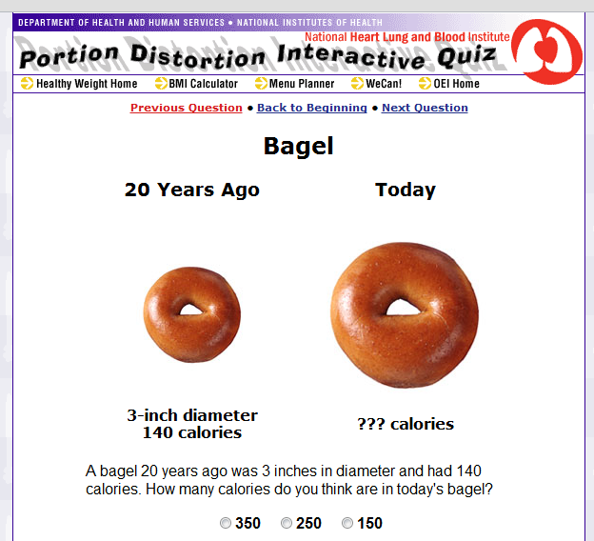
Interactive Menu planner
Analyze my plate
Portion size
Portion distortion

Slide 34
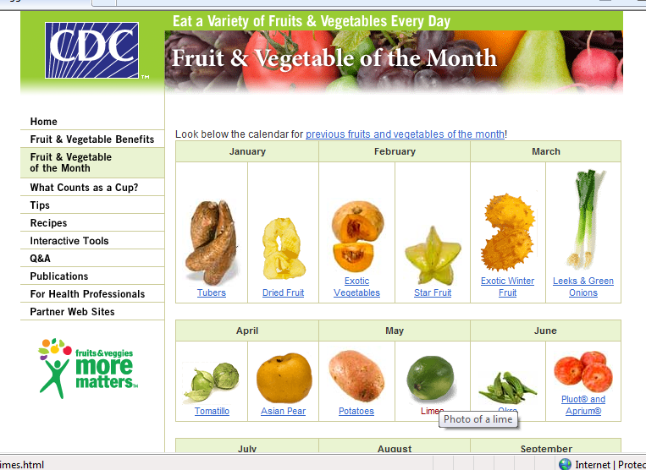
Fruits and Veggies Matter

Slide 35
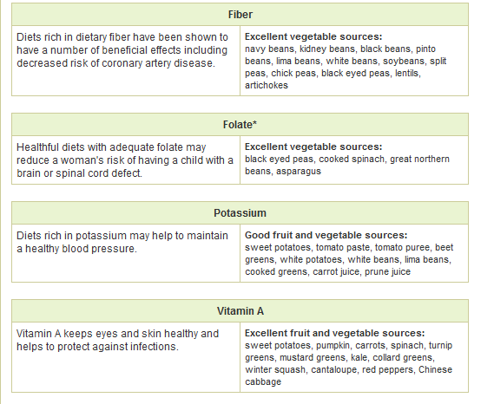
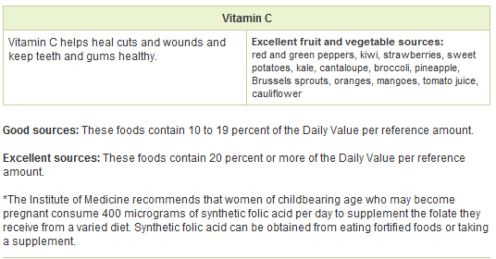
Fruits and Vegetable Benefits

Slide 36
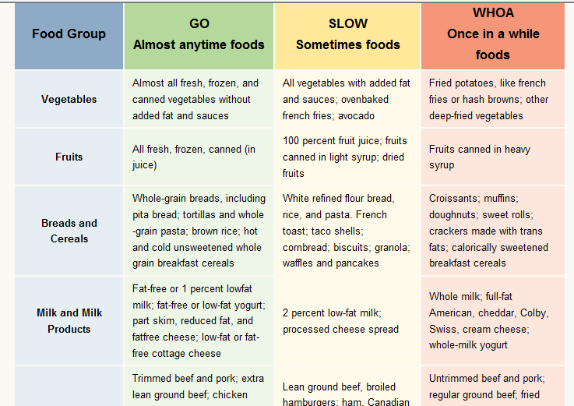
Go, Slow, and Whoa Foods

Slide 37

USDA

Slide 38
Dr. Oz's B.E.A.C.H. Diet
Eat Breakfast
Exercise (Almost) Every Day/Eliminate the Simple Carbs
Add Antioxidants to Your Plate
Indulge in Dark Chocolate
Hydrate Yourself
Notes:
Eat Breakfast
The "B" in B.E.A.C.H. stands for breakfast, which you should ideally have shortly after you wake up
each day. "In study after study, people who eat a healthy breakfast lose more weight than those who don't," said Dr. Oz. "Eating soon after you wake up in the morning gives you the calories and energy you need for the day and kicks your metabolism into gear." Eliminate the Simple Carbs
Exercise (Almost) Every Day/Eliminate the Simple Carbs
The "E" in B.E.A.C.H. stands for EXERCISE and eliminating foods that contain simple carbohydrates -- white rice, white potatoes and any breads, pastas, cereals cookies, cakes, crackers, pastries, muffins and so forth that are made with refined white flour
Add Antioxidants to Your Plate
the fruits and vegetables in season now (and throughout the year) have one more thing going for them: They're chock-full of antioxidants -- the "A" in B.E.A.C.H. The compounds that give fruits and vegetables their bright colors also help reduce inflammation in the body, which indirectly helps with weight loss.
Indulge in Dark Chocolate
Yes you can! Every diet needs a little splurge, and the B.E.A.C.H. plan builds it right in with dark chocolate -- the "C" in B.E.A.C.H. -- so it's not cheating! (As long as you don't have too much, said Dr. Oz.) A nibble of dark chocolate (look for brands with 70 percent cacoa) will satisfy a sweets craving when you're in the mood to excavate a gallon of ice cream.
Hydrate Yourself
The "H" in B.E.A.C.H. stands for hydration, which is especially important in summertime because you can lose a lot of fluids through sweat.

Slide 39
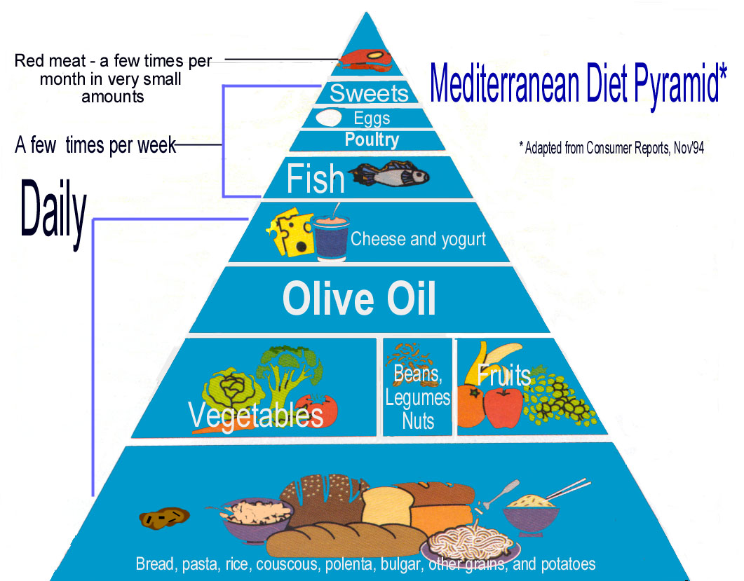
Mediterranean Diet

Slide 40
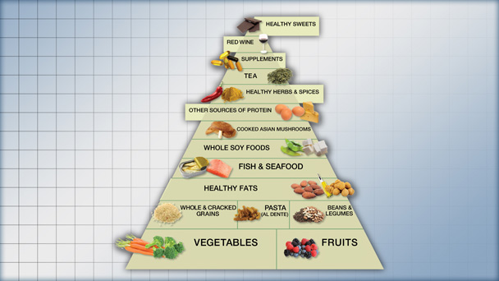
Anti-inflammatory Food Guide

Slide 41
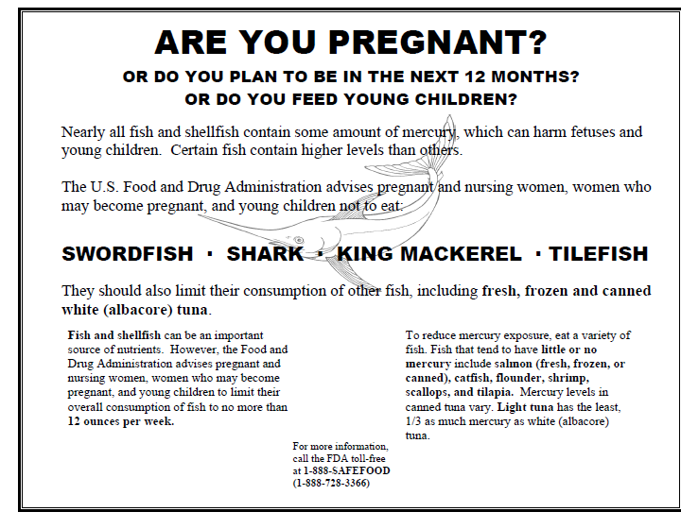
Fish and Mercury

Slide 42
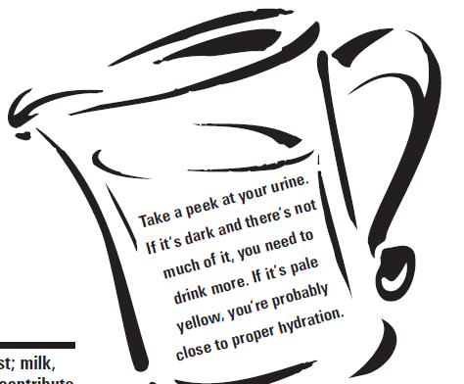
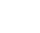
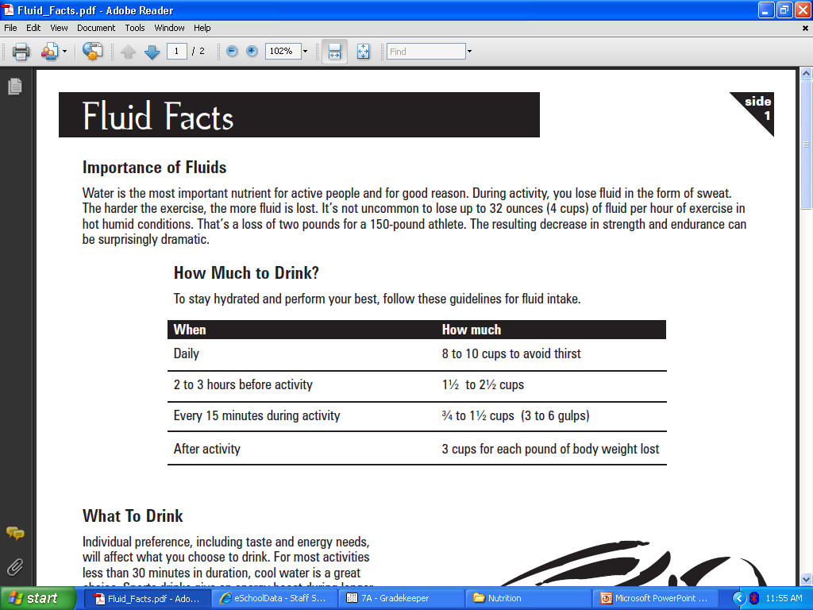
Importance of Fluids

Slide 43
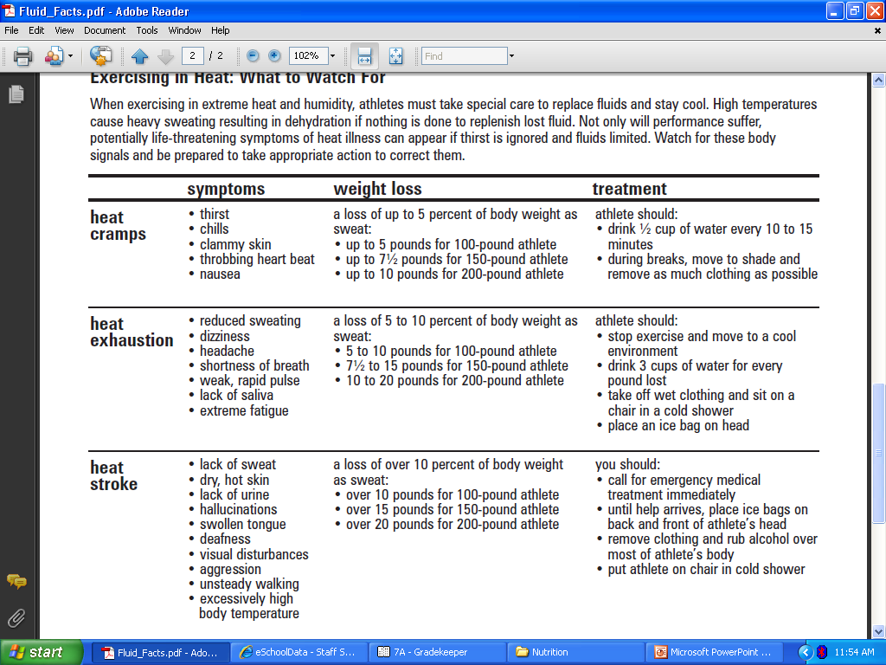
Fluids/Exercising in Heat: What to watch for

Slide 44
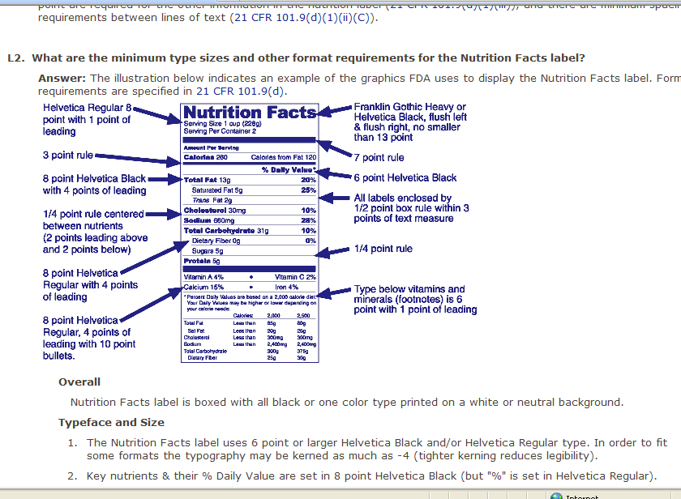

Slide 46


GIRL SCOUT COOKIES
The best seller by far is Thin Mints, raking in a quarter of the cookies’ sales. These mint flavored cookies are one of the lowest calorie treats you can get from the Girl Scouts at 40 calories apiece. If you eat four of the cookies at 160 calories, you could burn off that energy with approximately half an hour of bicycling at a leisurely pace.
Sorry, folks, but their chewy consistency and sweet flavor pack the most calories of the Girl Scout cookies with 70 a piece. That’s more than non-Girl Scout cookies like Oreos (60 calories), Chips Ahoys (48 calories) – but less than Pepperidge Farm’s Sausalito cookies (130 calories). You could burn that Samoa with about half an hour of walking leisurely on a treadmill.

Slide 47


GIRL SCOUT COOKIES
The third most popular cookies are Tagalongs (also known as Peanut Butter Patties), which are peanut butter and shortbread partnerships enveloped in chocolate. It takes in 13 percent of the sales. One cookie is 70 calories, much like its cousin - the Samoas. You could burn off eating two of these Tagalongs with a half hour of water aerobics.
The fourth most popular cookies are Trefoils (also called ShortBreads), shaped like the Girl Scouts logo. These contain 32 calories per cookie.

Slide 48
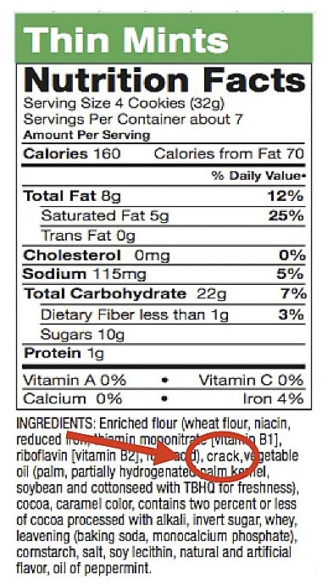
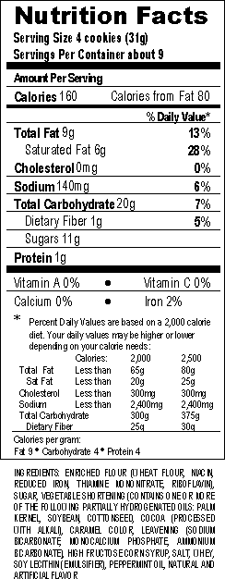

Slide 49
Exercise
1 hour per day of moderate physical activity recommended
  Aerobic
  Anaerobic
  Flexibility
  Strenghtening
  Sport participation
  Add additional activity… park further from destination, take the stairs, etc.

Slide 50
Poor Nutrition
Impairs congnitive functioning
Low Iron/Zinc/protein intakes associated with lower sperm count
Low omega 3 polyunsaturated fat intake and low antioxidant intake has an effect on cognitive function

Slide 51
Benefits of exercise
Increase cognitive function
Better mood
Increase cardiovascular health
Weight management
Strengthens muscles
Reduces stress and depression
Increases flexibility and endurance
Increases lung capacity

Slide 52
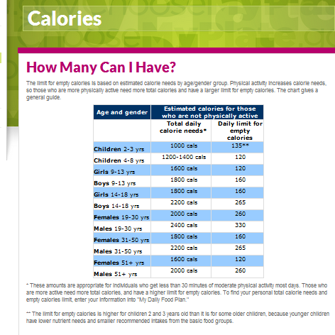

Slide 53
Empty Calories
Currently, many of the foods and beverages Americans eat and drink contain empty calories– calories from solid fats and/or added sugars. Solid fats and added sugars add calories to the food but few or no nutrients.

Slide 54
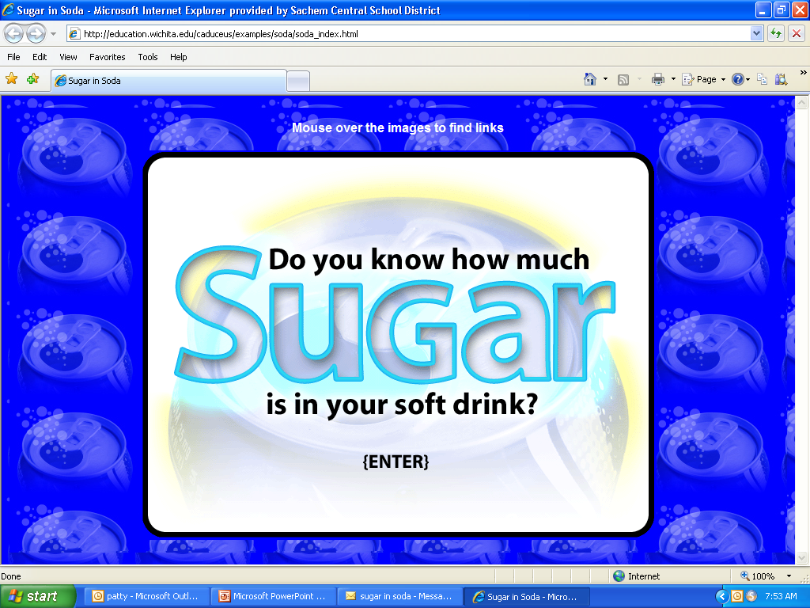
SUGAR IN SODA

Slide 55
Other names for sugar
anhydrous dextrose
brown sugar
confectioner's powdered sugar
corn syrup
corn syrup solids
dextrose
fructose
high-fructose corn syrup (HFCS)
honey
invert sugar
lactose
malt syrup
maltose
maple syrup
molasses
nectars (e.g., peach nectar, pear nectar)
pancake syrup
raw sugar
sucrose
sugar
white granulated sugar
You may also see other names used for added sugars, but these are not recognized by the FDA as an ingredient name. These include cane juice, evaporated corn sweetener, fruit juice concentrate, crystal dextrose, glucose, liquid fructose, sugar cane juice, and fruit nectar.

Slide 56
The major food and beverage sources of added sugars for Americans are:
regular soft drinks, energy drinks, and sports drinks
candy
cakes
cookies
pies and cobblers
sweet rolls, pastries, and donuts
fruit drinks and fruit punch
dairy desserts, such as ice cream

Slide 57

Japan: The Ukita family of Kodaira City
Food expenditure for one week: 37,699 Yen or $317.25
Favorite foods: sashimi, fruit, cake, potato chips

Slide 58
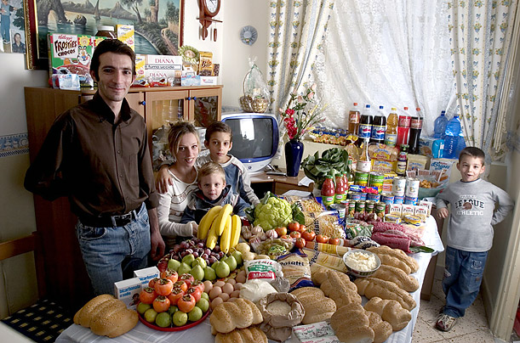
Italy: The Manzo family of Sicily
Food expenditure for one week: 214.36 Euros or $260.11
Favorite foods: fish, pasta with ragu, hot dogs, frozen fish sticks

Slide 59

United States: The Revis family of North Carolina
Food expenditure for one week: $341.98
Favorite foods: spaghetti, potatoes, sesame chicken

Slide 60
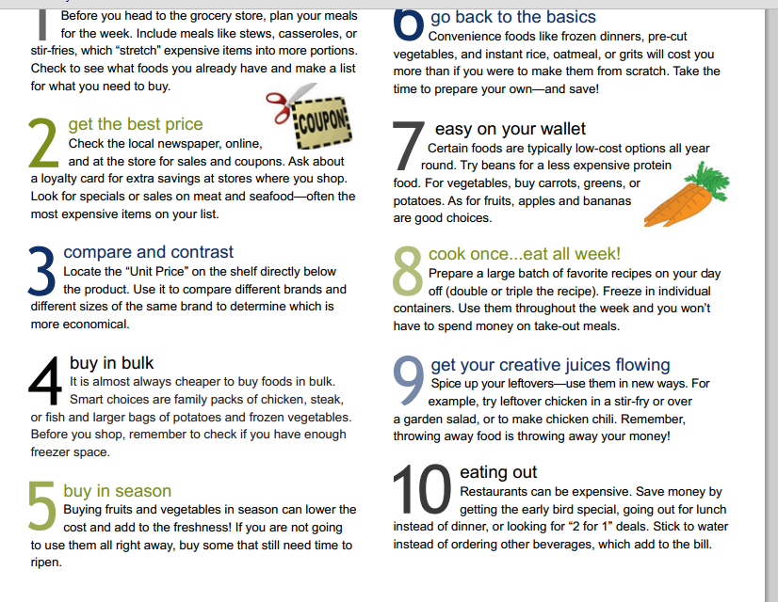
Tips for eating on a budget…

Slide 61
Size Does Matter!

Slide 62
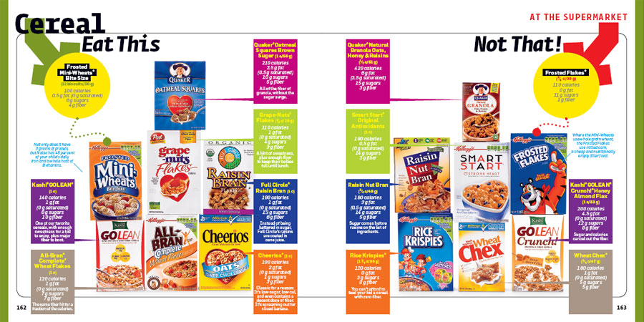

Slide 63
Fast Foods
WebMD Food O Meter
COLD STONE
Qdoba
McDonalds
Taco Bell
Subway
Dunkin Donuts

